Slide 1

ABP Community Talks 2022.3 DDD, EventHub & the ABP Book

Slide 2
ABP

Slide 3

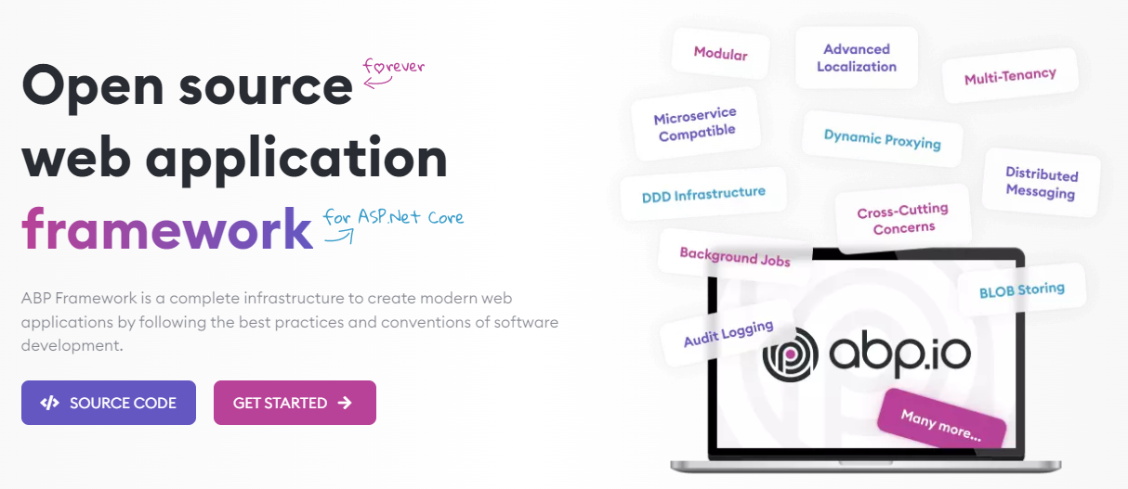
The ABP FRAMEWORK project https://abp.io --- https://github.com/abpframework

Slide 4
ABP Framework: Architecture
Domain Driven Design
& Layered Solution
Modular
Multi-Tenancy (SaaS infrastructure)
Microservice ready

Slide 5
ABP Framework: Infrastructure Enterprise application requirements
Cross-cutting concerns
Authentication & authorization
Distributed event bus
Audit logging
Background jobs
Data filtering & soft-delete
Dynamic client-side proxies
Dynamic forms
…more

Slide 6
ABP Framework: Startup templates

Slide 7
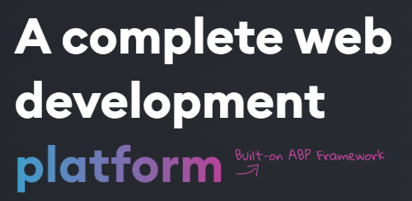
The ABP Commercial https://commercial.abp.io
Based on the ABP Framework:
Pro application modules
More pre-built application modules
Advanced UI themes
Code generation tooling
Microservice startup template
Premium support

Slide 8
EVENTHUB

Slide 9
EventHub
A reference application for implementing DDD.
Explained in the Mastering ABP Framework book.

Slide 10
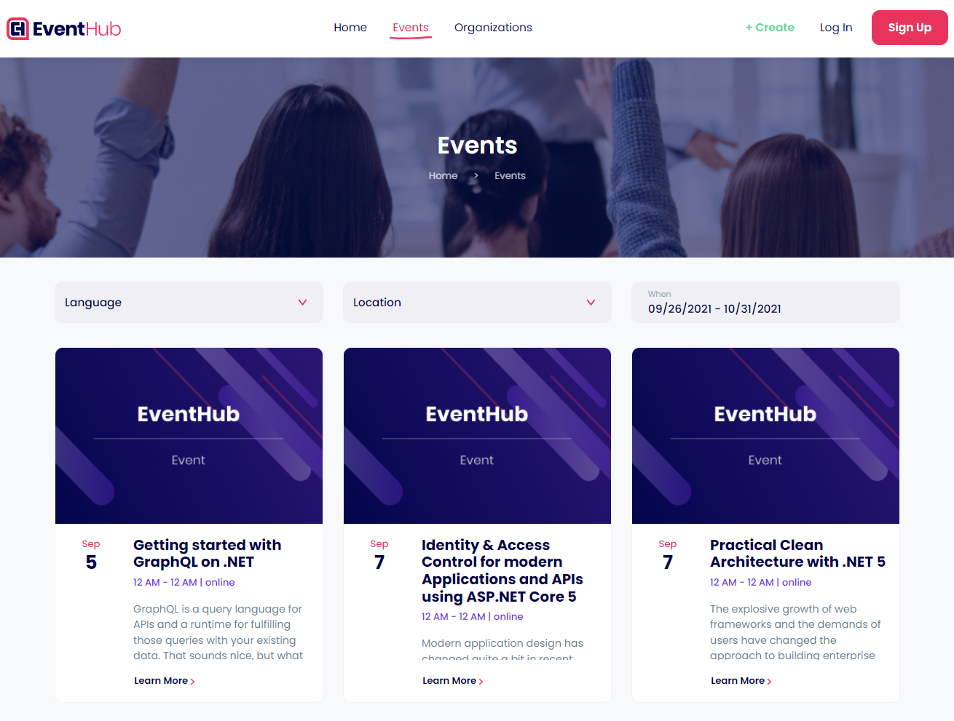
EventHub: The application

Slide 11
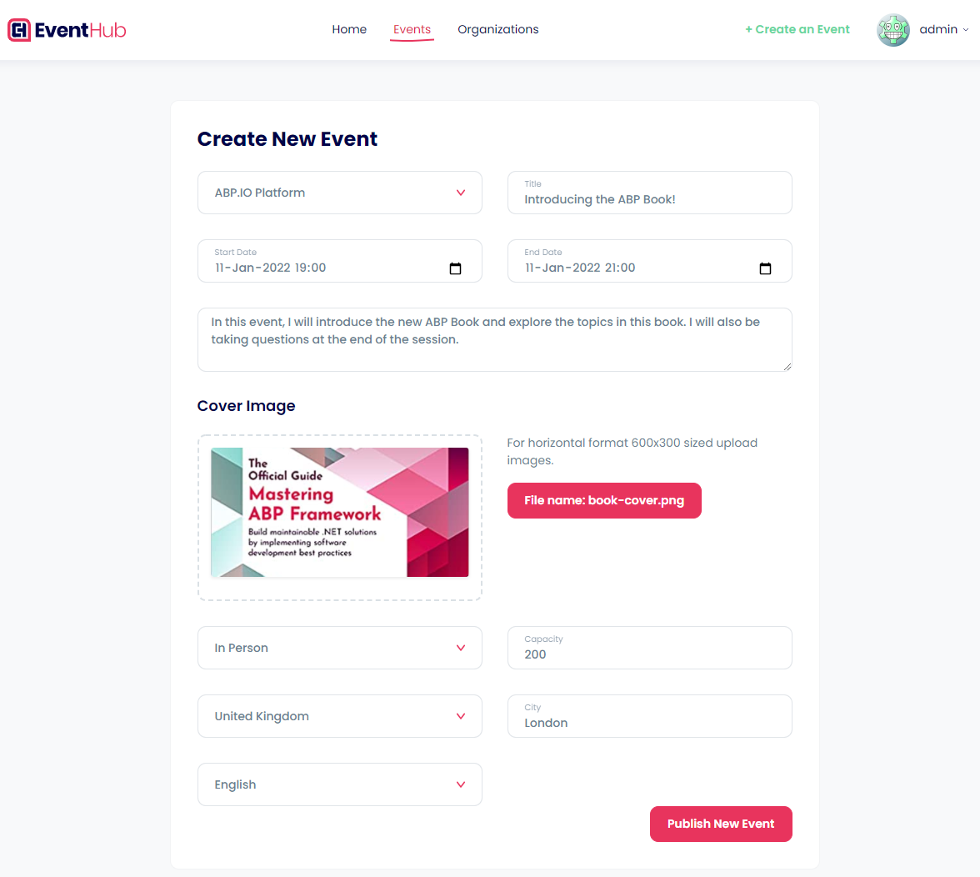
EventHub: The application

Slide 12
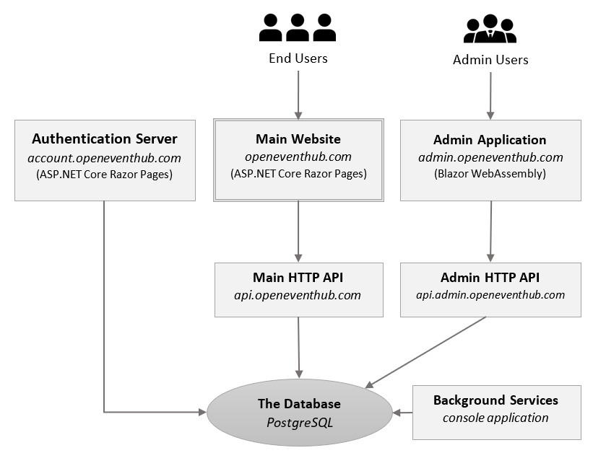
EventHub: The architecture
Two web applications:
Main website (Razor Pages)
Admin application (Blazor WASM)
Authentication server (built with the IdentityServer4)
Two API endpoints (one for each web application)
Background service (console application)

Slide 13
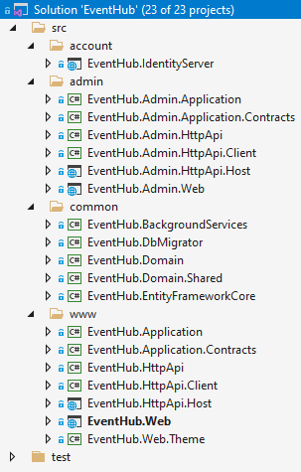
EventHub: The architecture
Two web applications:
Main website (Razor Pages)
Admin application (Blazor WASM)
Authentication server (built with the IdentityServer4)
Two API endpoints (one for each web application)
Background service (console application)

Slide 14
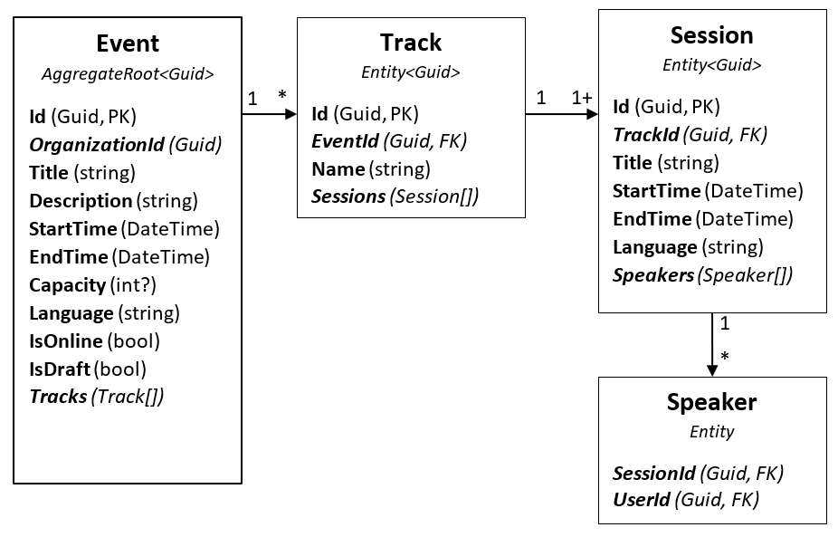
EventHub: The domain

Slide 15
EventHub: Source code
https://github.com/volosoft/eventhub

Slide 16
Title
TODO: ...

Slide 17
Title
TODO: ...

Slide 18
Title
TODO: ...

